Slide 1
Travel Advisor using
Web Technology
Presented By: Nilesh Hupare
Prasad Magar
Mahesh Mohite
Afrid Pathan

Slide 2
Introduction:-
The Travel Companion project is a React-based web application designed to revolutionize travel planning and enhance the overall travel experience.
Emphasize that travel is more than just moving; it's about exploration, discovery, and creating lasting memories.
The Travel Advisor project is a web-based platform designed to assist users in planning their travel experiences efficiently and effectively.
Leveraging the latest web technologies, this project aims to provide comprehensive and personalized travel recommendations, itineraries, and information to users worldwide.

Slide 3
Problem Statement:
Develop a web application that serves as a comprehensive travel advisor, offering users personalized trip recommendations, itinerary planning, real-time weather updates, and local insights to enhance their travel experiences.
The platform should integrate user preferences, and location specific data to create seamless and memorable journeys

Slide 4
Existing System: These existing systems typically offer a combination of user-generated content, curated recommendations, and travel-related information to assist travelers in planning their trips effectively. Each platform has its unique features and strengths, catering to different preferences and needs within the travel advisory space.
Proposed system :
Destination recommendations based on user preferences.
Itinerary planning with optimized routes and activities.
Interactive maps for visual trip planning.
Reviews and ratings for informed decisions.

Slide 5
Project Objectives:-
Simplifying travel planning and making it seamless, enjoyable, and stress-free.
Travel Companion caters to both solo adventurers and groups, offering features for various types of travelers.
Personalized recommendations tailored to individual preferences.
Streamlined trip planning for efficient organization.
Comprehensive information on destinations, accommodations, and activities.
Enhanced user experience with intuitive interfaces and real-time updates.

Slide 6
Benefits of Travel Advisor:
Accommodation Search
Restaurant Recommendations
Attractions Recommendations
User-friendly interface
Mobile responsiveness
Real-time updates and alerts

Slide 7
Project Development Process:-
Research & Planning: Understand user needs, define objectives, and plan features.
Design: Create wireframes and mockups for user interface and experience.
Technology & Infrastructure: Select tools, set up servers, and databases.
Development: Build features iteratively using agile methodologies.
Data Integration & Content Management: Access and organize travel data.
Testing & Quality Assurance: Ensure functionality, performance, and usability.
Deployment & Launch: Go live after final checks and marketing strategies.
Monitoring & Optimization: Analyze metrics, gather feedback, and update accordingly.
Continuous Improvement: Iterate based on feedback, trends, and advancements.

Slide 8
Features and Functionality:
Search and tracking capabilities
Personalized recommendations
Location-based services
Destination Recommendations
Interactive Map
Reviews and Ratings
Social Integration
Real-time Updates

Slide 9
REQUIREMENT SPECIFICATION:
1] SOFTWARE REQUIREMENTS:
Operating system: Windows XP or higher.
Technology Used: Google map APIs, Places APIs
IDE: Visual Studio Code
Language: HTML, CSS, JavaScript, React.js.
Database: Firebase
2] SYSTEM REQUIREMENTS:
System Processor: Intel i3 or relevant.
Memory: minimum 4GB of RAM & 256GB SSD.
Display: 1024x 768 or higher-re solution display

Slide 10
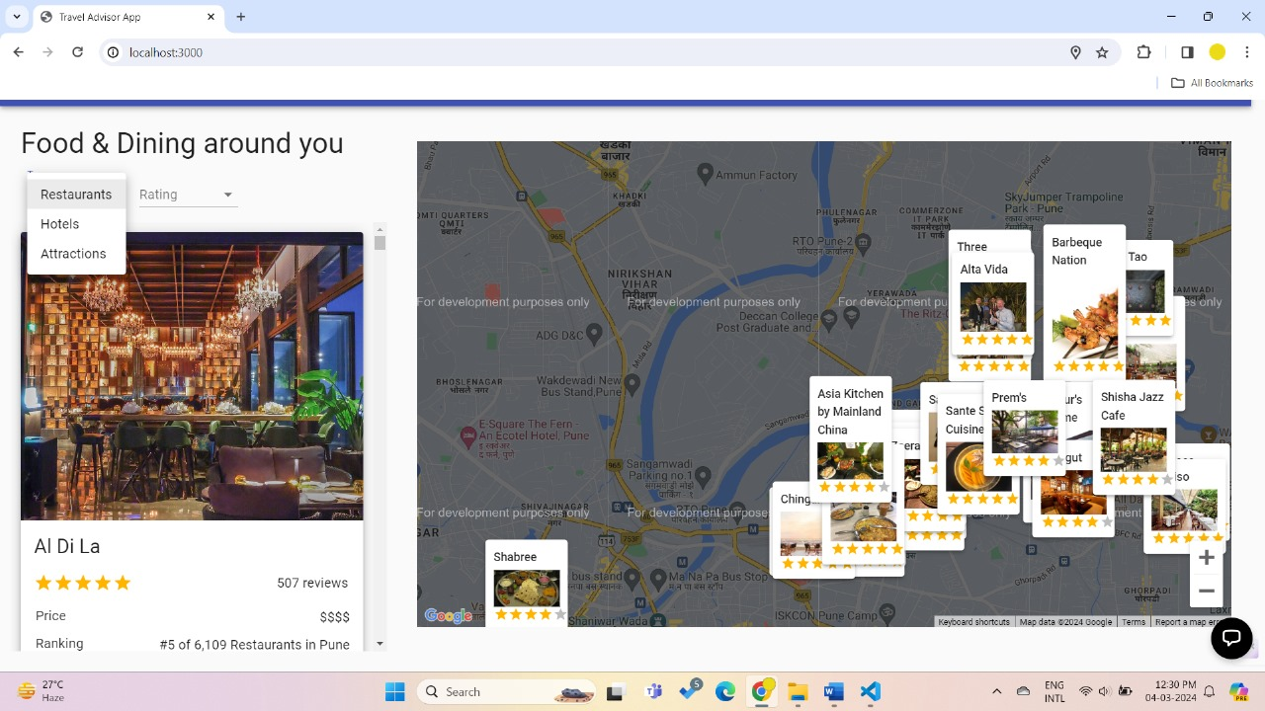
Snapshots: 1.Searching for Restaurants

Slide 11
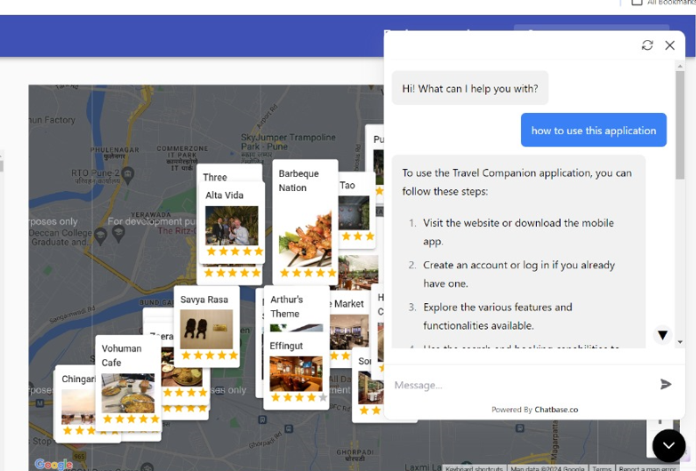
Snapshots: 2. Implementing Chatbot

Slide 12
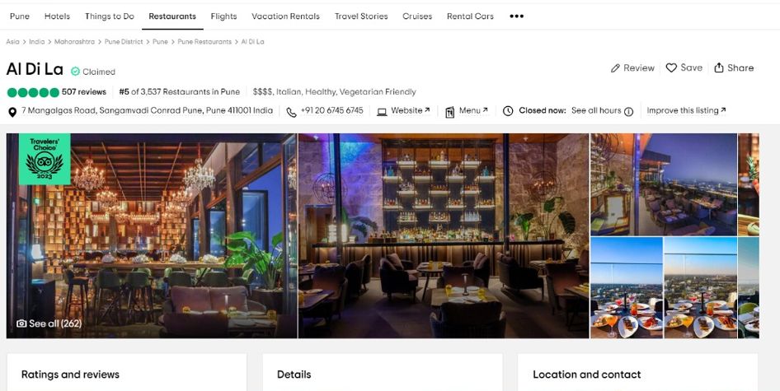
Snapshots: 3. Reviewing Restaurant

Slide 13
Conclusion:
The Travel Companion project represents a significant step forward in redefining how we plan, organize, and experience our journeys.
We've carefully crafted a web application that caters to the needs of both solo adventurers seeking new horizons and groups of friends planning the ultimate getaways. Our goal is to make travel planning a collaborative, efficient, and enriching experience.

